Slide 1
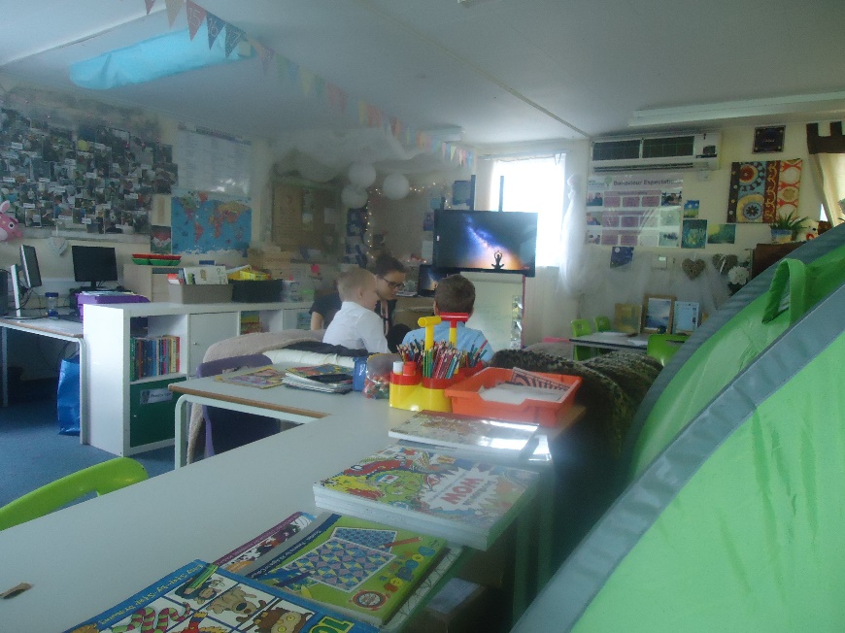
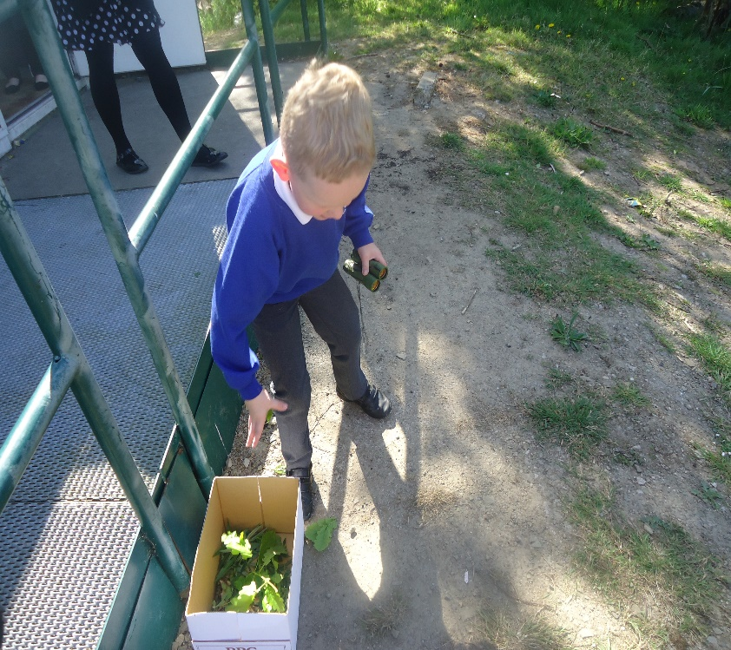

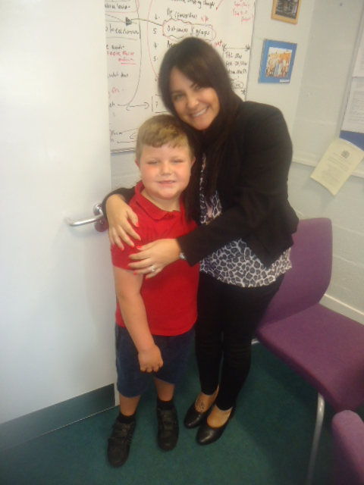
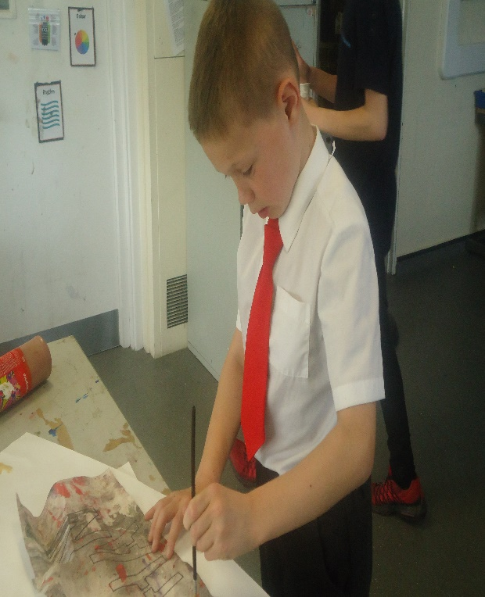
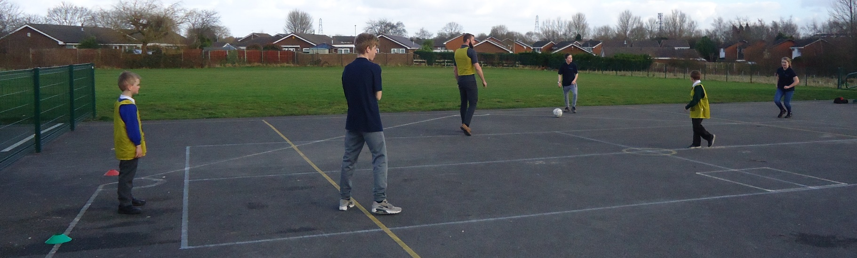
LRA New Horizons Update
17th May 2018

Slide 2
TBAP - Update
TBAP – Tri-Borough Alternative Provision
Conversion to an AP/SEMH Special MAT on 1st January 2018
Values and beliefs of the Trust completely align with New Horizons
We will continue to offer the same quality provision to vulnerable learners
Staffing team remains the same but the structure has an Executive Head teacher for TBAP North West (KT) and each school has a “Head of School” (SRW)
New Horizons is the “Hub” school but more in the North West will be joining the Trust

Slide 3
New Horizons Update
We have 56 learners aged 5-16
We continue to have excellent outcomes for learners – significantly above NA for AP
We have nominated learners and won two British Education Awards in the last 2 years
We are currently being judged for a Pearson Teaching Award – Reached the finals for Teaching Assistant of the Year
We are currently working with “The Difference” – Kiran Gill who has presented to the Parliamentary Select Committee re National Inquiry into AP; we have also had parents representing at the select committee

Slide 4
New Horizons- Key information
We are specialists in “Trauma Informed” approaches
Our learners have often suffered significant trauma/ACEs (89% of current cohort have 2 or more)
We ask the question “What has happened to you?” before we ask “Why are you doing that?”
Every interaction matters with our learners…staff are trained the same, no matter who they are: Head of school, teacher, BSP, caretaker
We don’t shout. Shouting escalates situations. Staff are trained to respond without emotion. We have to deescalate- everything depends on this…
We have had 188 safeguarding/welfare concerns since September… all learners are with us for a reason
https://vimeo.com/189604325

Slide 5
Concerns raised through LRA You said, we did (or we have tried to…)
We have increased our duty points outside school (Raj’s shop, gates etc)
We have ensured staff are always parked on the car park
We ask all visitors to ensure they are parked sympathetically – they are told to park on the car park if we can facilitate it, not on the shop car park, not in the bay and not blocking any residents
Head of School has regular contact with DP from LRA. We have half termly meetings and Dave is in regular contact via phone and email
We have regular conversations with learners around behaviour in the community and liaise closely with agencies including police, social care, YOT, psychology and health

Slide 6
Next steps…
We want to be part of the local community… we recognize this was your primary school and it is very different now.
We will always welcome volunteers! Keen gardeners to support our sensory garden project?
We will have a new mini bus in September so we are hopeful this will help remove some learners from outside the site
Contact me…
newhorizonsadmin@tbap.org.uk

